Slide 1

Dynamic Generation of Modular Industrial Plant Visualizations
Weekly Meeting 11
Miguel Romero Karam

Slide 2
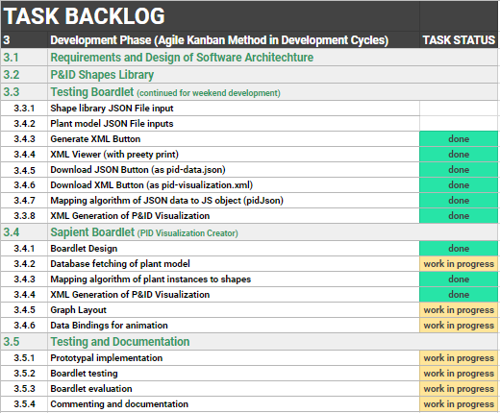
Task Backlog – Overview Overview of tasks: Week 11

Slide 3
Task Backlog – Overview Overview of tasks: Week 10

Slide 4
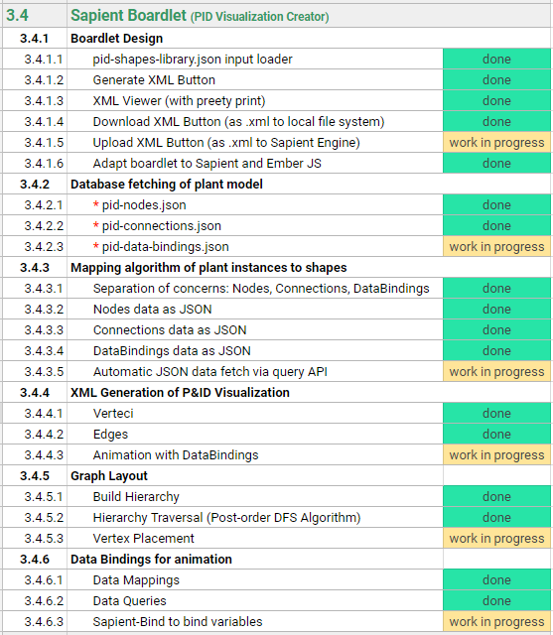
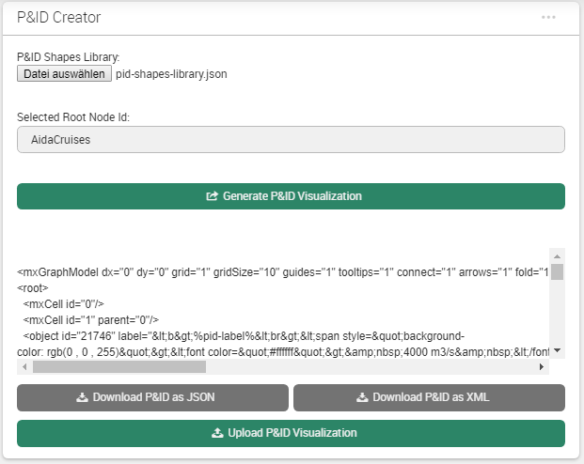
Sapient Boardlet Weekly Sprint 10

Slide 5
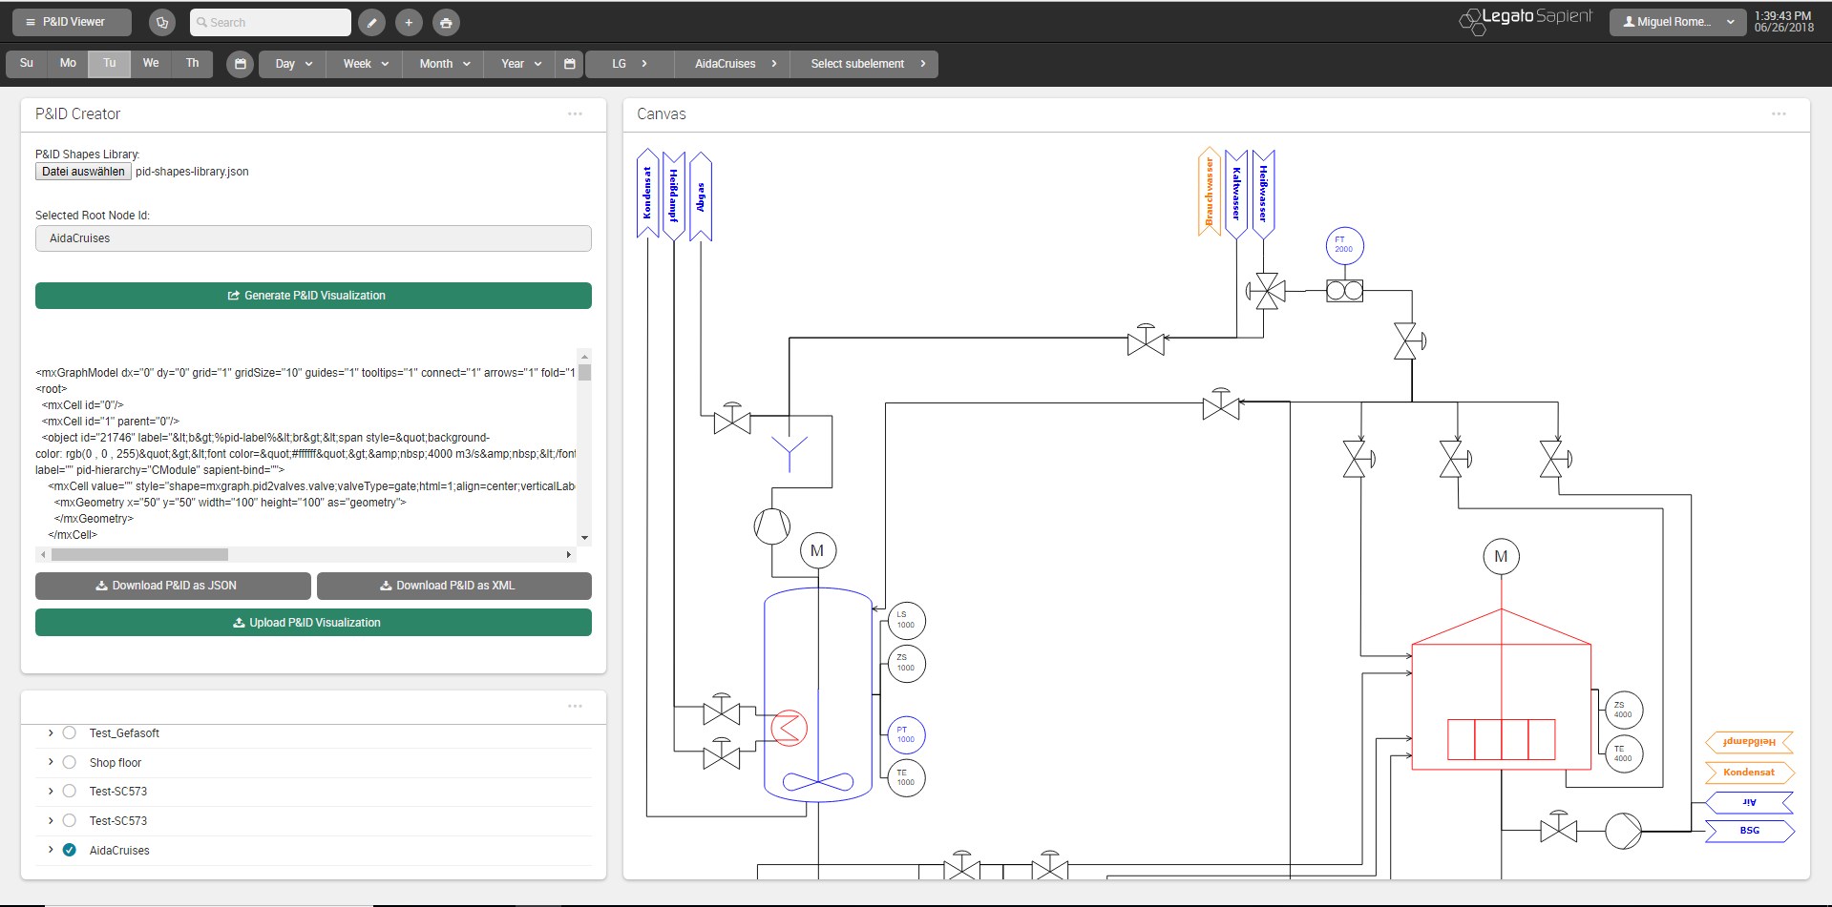
P&ID Viewer - Dashboard

Slide 6
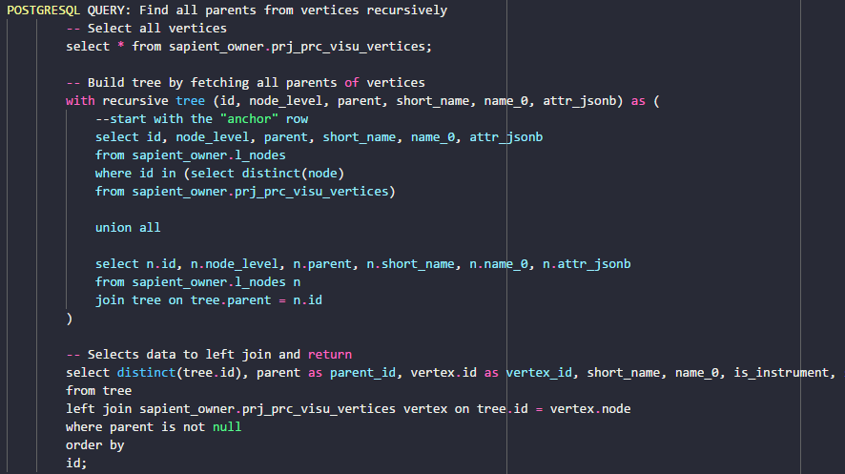
SQL Queries Weekly Sprint 10
Complex SQL Query with LEFT JOIN
l_nodes
Wanted Query Data
visu_vertices
LEFT JOIN ON tree.id = vertex.node

Slide 7
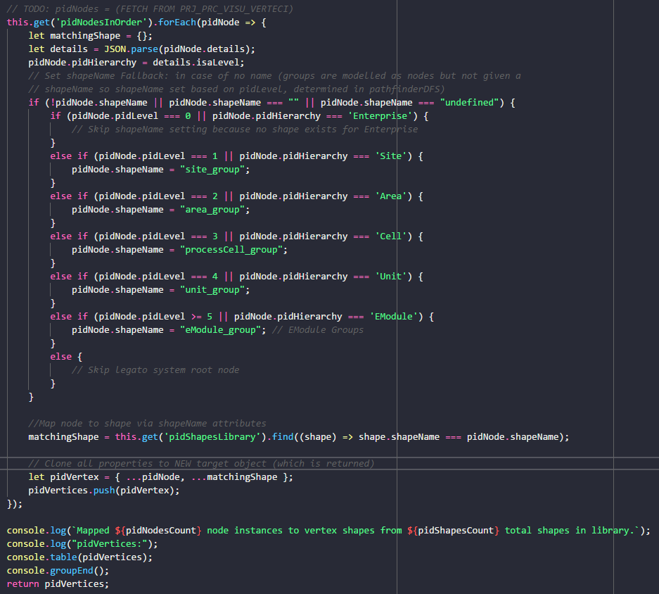
mapNodesToShapes() Weekly Sprint 10

Slide 8
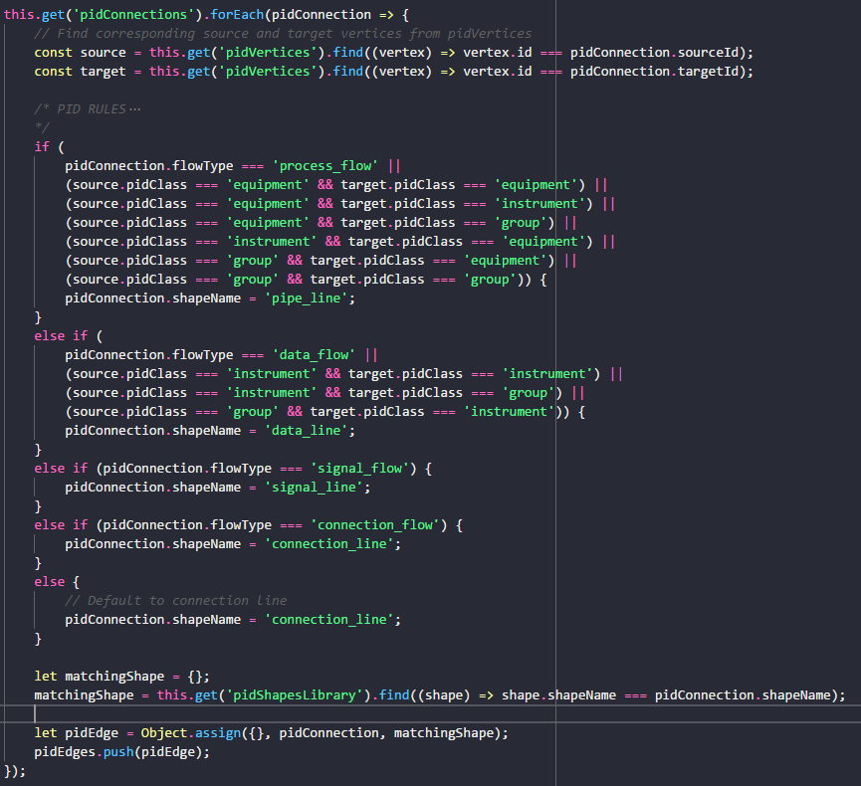
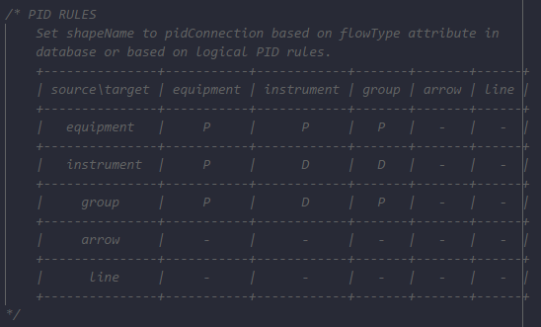
mapConnectionsToShapes()
P&ID Rules to determine shapeName according to pidClass of source and target shapes of connection.
Rules as Adjacency Matrix:

Slide 9
Next Sprint – ToDos Weekly Sprint 10
Boardlet Design
Fix floating buttons (side-by-side)
Design of root-node-selection input field
Fix query of siblings when selecting one root node
Build Hierarchy Function
Fix to start from selected root node (to work out for multiple)
Database queries
Connect remaining tables to repository with LC2 (instructions in daily-routine notes)
getData() generic Function
pidRootNode name query (to display in input field on updateInput())
pidNodes query
pidConnections query
Process Variables query
Animations via sapient-bind
Documentation and Commenting
Modularization of code
JsDocs
Testing

Slide 10
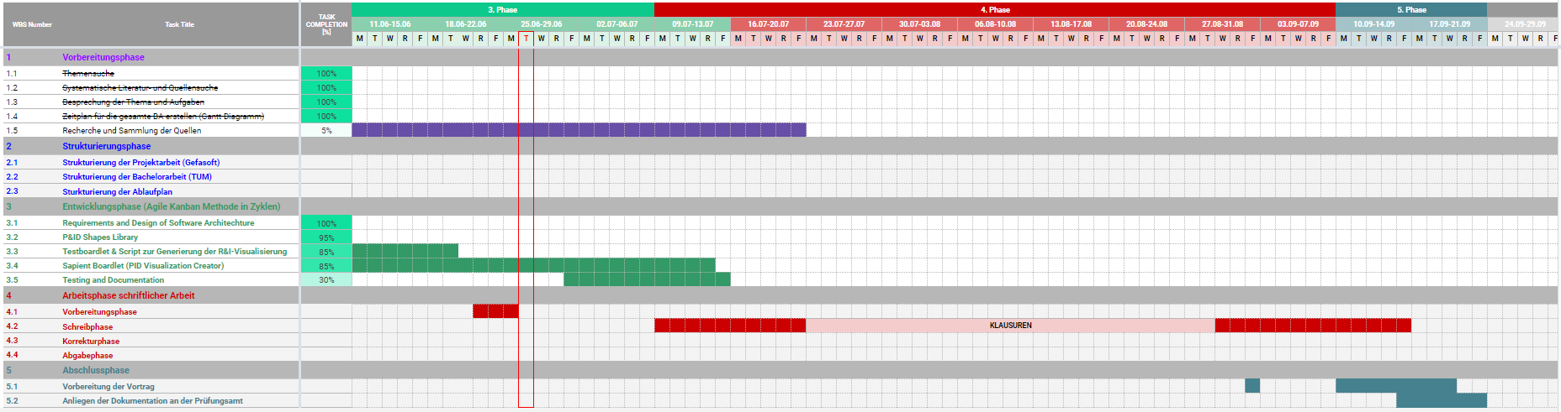
Project – Overview Overview of tasks: Week 10

